Slide 1

Machine Learning Project
Roll no – A21012
Name – Gautam Kharbanda
DS_Fall – kolkata
05.03.2022

Slide 2

Customer Churn Prediction using Machine Learning and Spark

Slide 3
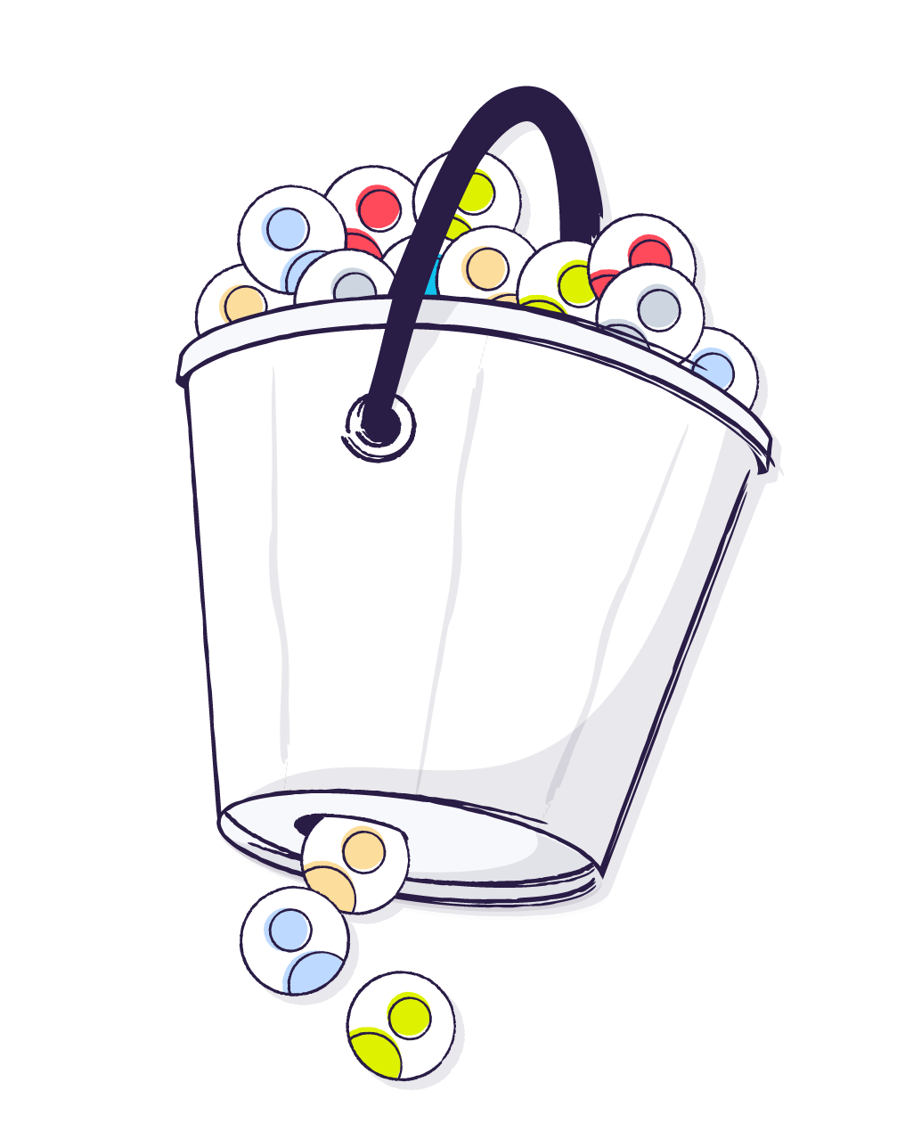
Background
Customer attrition, also known as customer churn, customer turnover, or customer defection, is the loss of clients or customers. The churn rate, also known as the rate of attrition or customer churn, is the rate at which customers stop doing business with an entity. For example, if there are number of customers continuously buying the products from Brand’ A’, some of the customers of ‘Brand ‘A’, shift to Brand ‘B’, that is called customer churning for Brand ‘A’.
The objective is to predict customer churn on the basis of available dataset. Churn prediction minimizes customer defection by predicting that, which customers are likely to cancel their association with product or service.

Slide 4
Problem Description
There is a marketing agency, that has number of customers using their service to produce ads for the client / customer websites. They have noticed quite a bit of churn in the numbers of their clients. Currently, Agency has a plan to assign account managers right now to minimize customer churning.
Hence, there is need to create a machine learning model that will help to predict which customers are likely to get churned, who will stop buying their service in future, so that, Agency can correctly assign the customers most at risk to churn an account manager.
Agency has provided some historical data. We need to create a classification algorithm that will help to classify customer churning based on given data. Agency will be able to test this outcome against incoming data for future customers to predict which customers will churn and assign them an account manager, accordingly.

Slide 5

Degree of Problem Statement
Fierce competition has raised the cost of acquiring new customers, making imperative to determine which customers are likely to churn, so business can take the necessary steps to prevent the latter from leaving.

Slide 6

Problem Solution Approach (Tools and Techniques) :
Marketing Agency has provided some historical data and new customer dataset. Marketing Agency wants to know which customers are most likely to churn given this new customer data.
We create a classification algorithm by applying ‘Logistic Regression’ to classify customer churning based on given data, to predict the churning from given dataset.
Once we create the model and evaluate it, we will test out the model on provided new customer dataset.
Based on the results, Marketing Agency will be able to initiate corrective measures by assigning account managers to churning customers.

Slide 7
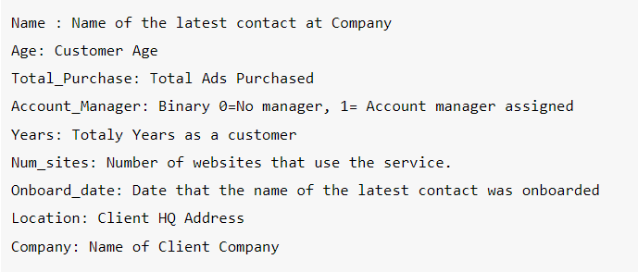
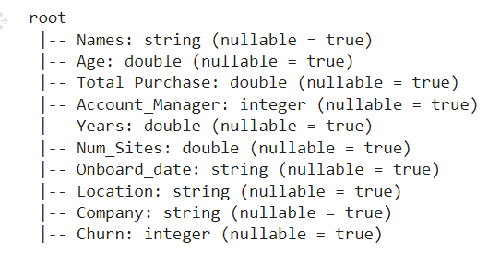
Problem Solution Approach (Tools and Techniques) :
Data Format and Schema:

Slide 8
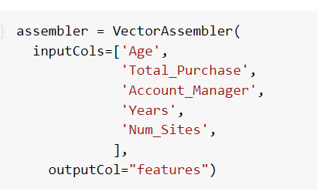
Problem Solution Approach (Tools and Techniques) :
Vector Assembeler
In order to combine given list of columns into a single vector column, transformed data using Vector Assembeler .

Slide 9
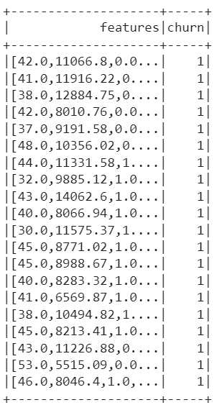
Problem Solution Approach (Tools and Techniques) :
Using Spark, we executed Feature processing and Model Training.
Created Test, Train, and splitting into 70:30

Slide 10
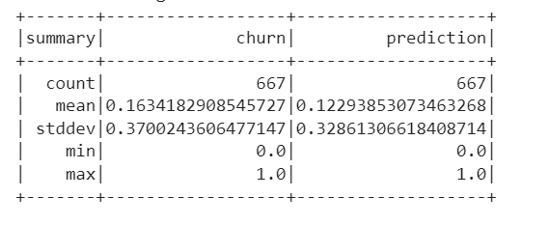
Problem Solution Approach (Tools and Techniques) :
Fit the Model and executed Prediction based on Machine learning Model

Slide 11
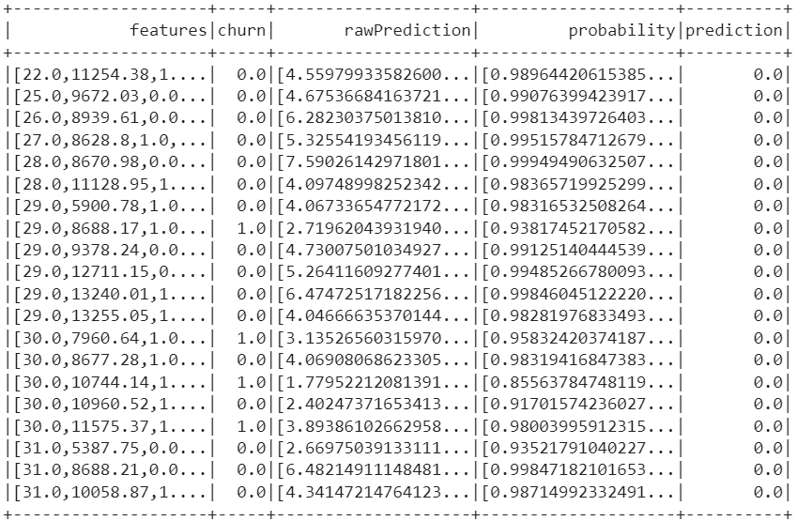
Problem Solution Approach (Tools and Techniques) :
Prediction Summary

Slide 12
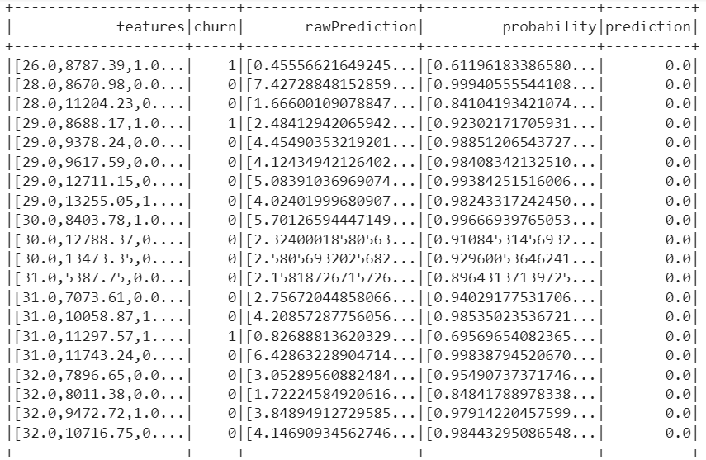
Problem Solution Approach (Tools and Techniques) :
Model Evaluation

Slide 13
Problem Solution Approach (Tools and Techniques) :
Comparison of Actual Tested and Evaluated

Slide 14
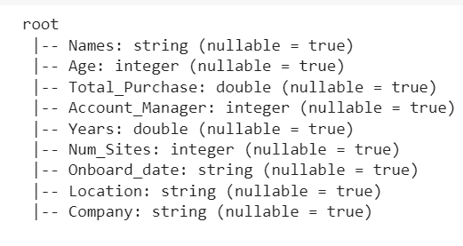
Problem Solution Approach (Tools and Techniques) :
Applying New Customer Dataset for Churning Prediction

Slide 15
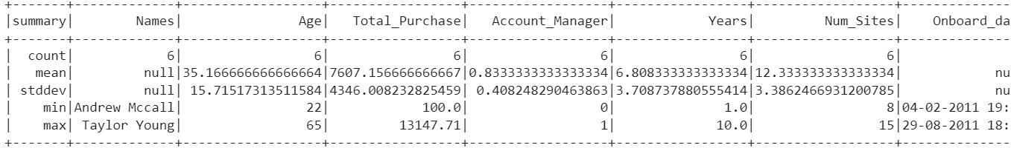
Problem Solution Approach (Tools and Techniques) :
Summary statistics on New Customer Data

Slide 16
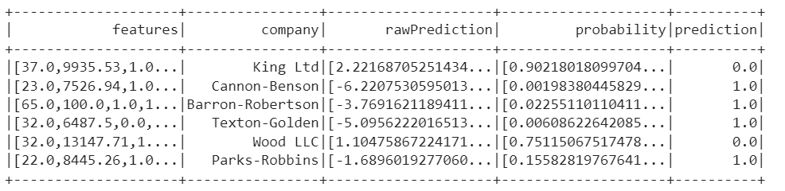
Problem Solution Approach (Tools and Techniques) :
Final Results - Prediction

Slide 17

Results achieved:
Based on our model, Results show that out of Six (6) new customers, Four (4) customers will get churned as per projected outcome. These Four (4) customers are as follows:
Cannon-Benson
Barron-Robertson
Texton-Golden
Parks-Robbins

Slide 18

General discussion
Considering the prediction model outcome, Agency would require to focus on churning customers from new database.
In case of more customer added to new customer database, results most probably will provide similar outcome with churning data, which Marketing Agency can revalidate with more new customer database, as and when needed in future,
Recommendation:
Dedicated account managers for these churning customers to be assigned by Marketing Agency, on immediate basis.
Marketing Agency to refer future new customer data to predict the projected churning towards implementing cautious measures to curb customer churning

Slide 19
Thank You

